Slide 1



PIZZA
SALES

Slide 2


welcome to
sql project
Hello everyone, my name is Nikita Shinde. In this project, I have utilized SQL queries to analyze and answer various business-related questions based on pizza sales data. The objective is to extract valuable insights such as sales trends, customer preferences, and product performance to support data-driven decision-making.

Slide 3

• SQL (Structured Query Language) is used to manage and manipulate databases.
• It helps to retrieve, insert, update, and delete data efficiently.
• This project focuses on learning SQL through Question–Answer based queries.
• It improves practical understanding of database concepts.
INTRODUCTION

Slide 4


SQL Commands Used :-
• SELECT – Retrieve data from tables.
• INSERT – Add new records.
• UPDATE – Modify existing data.
• DELETE – Remove records.
• WHERE, ORDER BY, GROUP BY – For filtering and sorting

Slide 5
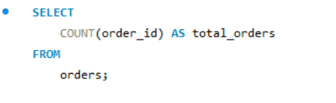
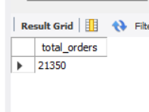
o
Retrieve the total number of orders placed ?
Output :-
$20
$out30

Slide 6
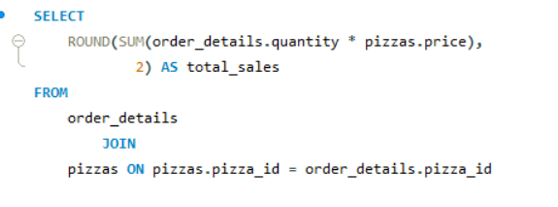
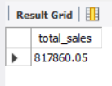
Calculate the total revenue generated from pizza sales ?
Output :-

Slide 7
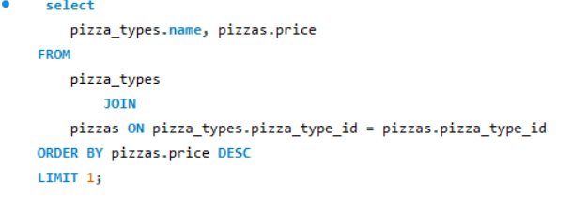
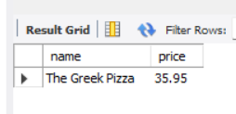
Identify the highest-priced pizza ?
Output :-

Slide 8
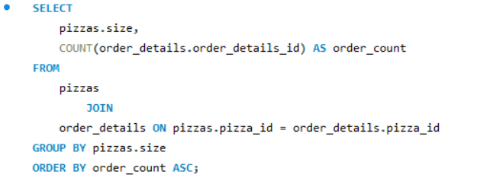
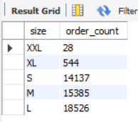
Identify the most common pizza size ordered?
Output :-

Slide 9
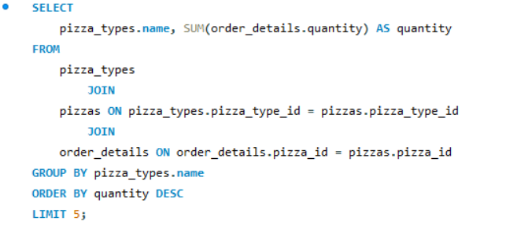
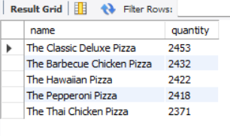
List the top 5 most ordered pizza types
along with their quantities?
Output :-

Slide 10
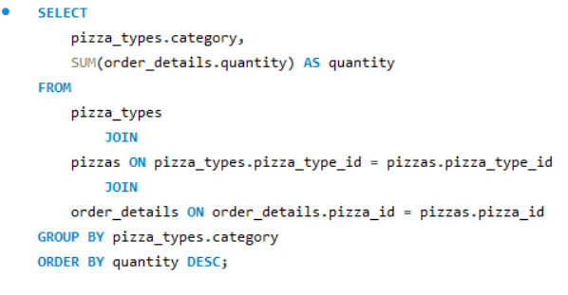
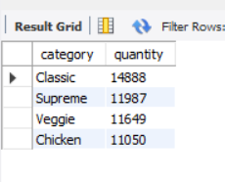
Join the necessary tables to find the total quantity-- of each pizza category ordered?
Output :-

Slide 11
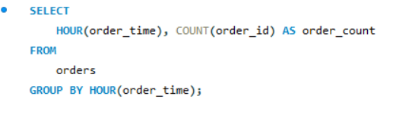
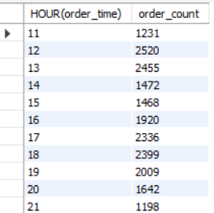
Determine the distribution of orders by hour of the day?
Output :-

Slide 12
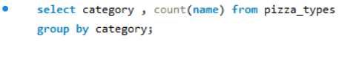
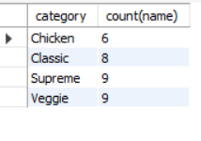
Join relevant tables to find the category-wise distribution of pizzas?
Output :-

Slide 13
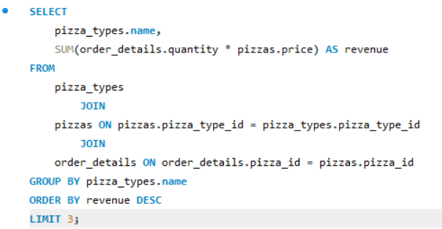
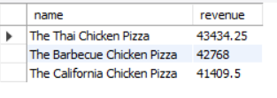
Determine the top 3 most ordered pizza types based on revenue?
Output :-

Slide 14
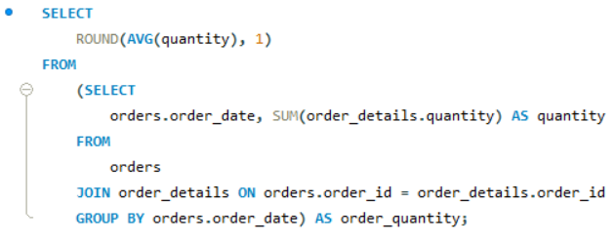
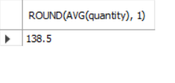
Group the orders by date and calculate the average number of pizzas ordered per day?
Output :-

Slide 15
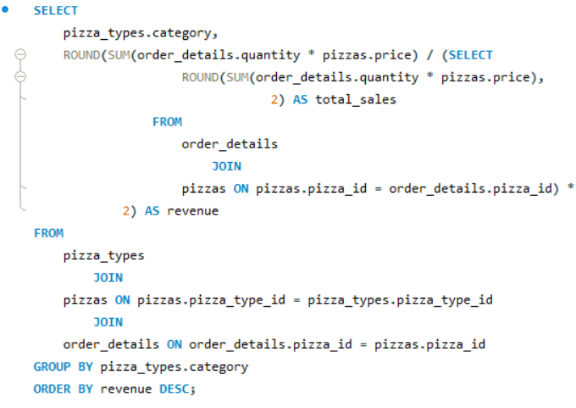
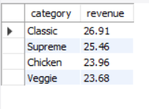
Calculate the percentage contribution of each pizza type to total revenue?
Output :-

Slide 16
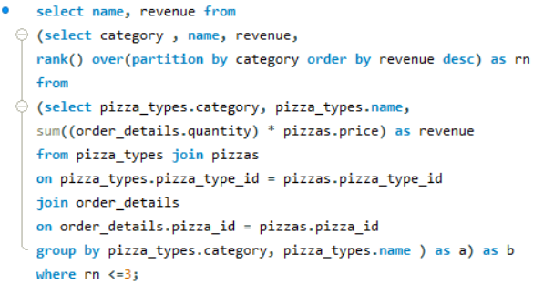
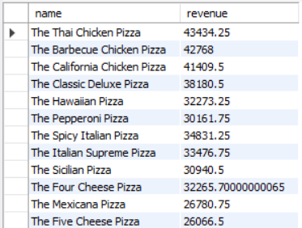
Determine the top 3 most ordered pizza types based on revenue for each pizza category?
Output :-

Slide 17
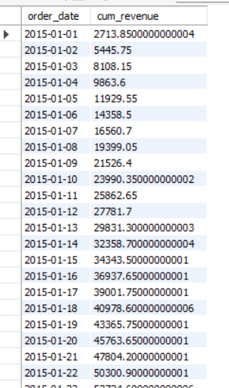
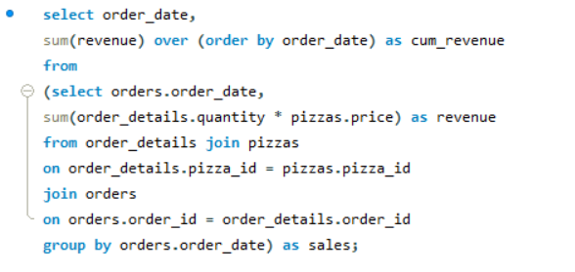
Analyze the cumulative revenue generated over time ?
Output :-

Slide 18

BENEFITS
• Easy to understand SQL concepts.
• Practical and exam-oriented.
• Helpful for beginners and engineering students.
• Can be extended with advanced queries.

Slide 19
CONCLUSION
• SQL is an essential skill for database management.
• Learning through Question–Answer format makes it more effective.
• This project builds a strong foundation in SQL.
• Future scope includes advanced queries and real databases.

Slide 20
THANK YOU !

